Slide 1

Maulana Azad National Institute of Technology Bhopal, India, 462003
Department of Computer Science and Engineering MINOR PROJECT REPORT
Semester 6
Neural Network Based Pattern identification of different human joints for different human walking styles using inertial measurement unit (IMU) sensor
Submitted by:
Nikita Chauhan 181112231
Duppati Sahithi 181112236
Niharika Shilpi 181112255
Rajeshwari Pandravisam 181112261
o add text
Under the guidance of
Dr. Vaibhav Soni Sir

Slide 2
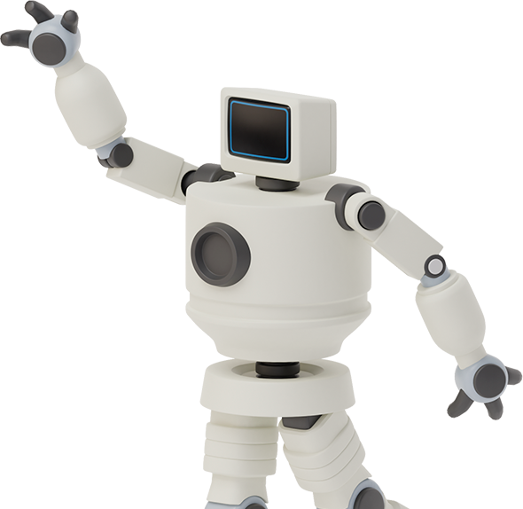

TREADMILL GAIT ANALYSIS

Slide 3
TOPICS COVERED
Introduction
Data Set Used
Code
1
3
5
2
4
6
Aim of the project
Models tested
References

Slide 4
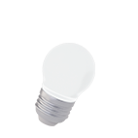
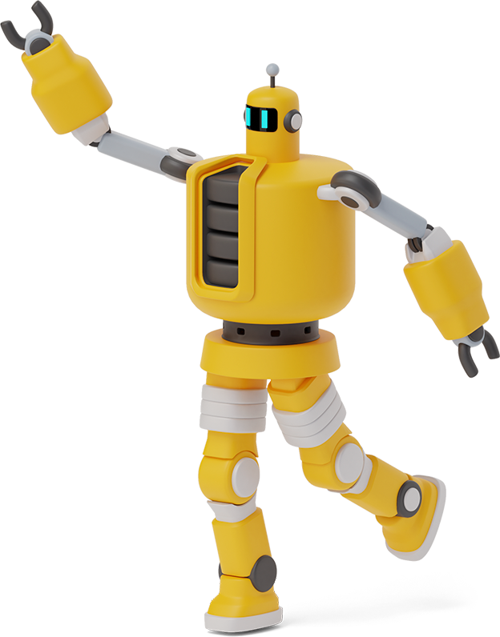
Aim of the project
Neural Network based Pattern identification of different human joints for different human walking styles.

Slide 5
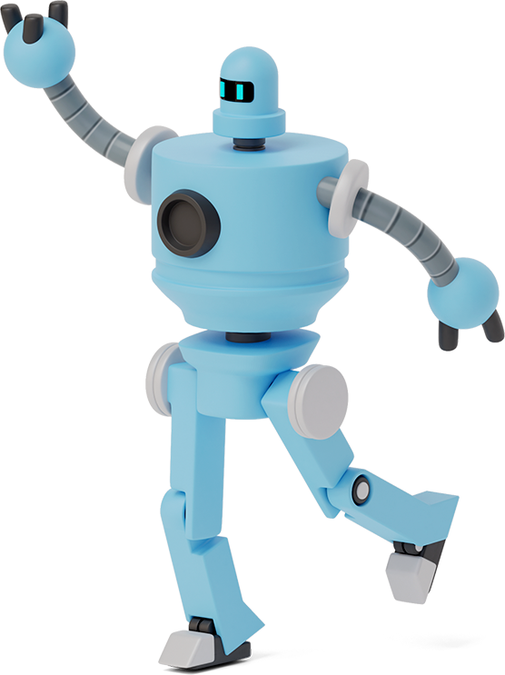
What is Gait?
- Human gaits are the various ways in which a human can move, either naturally or as a result of specialized training.
What is Gait Analysis?
- Gait analysis (GA) has been widely used to better understand the gait patterns of a wide range of populations. The application of this method has the ability to distinguish between normal and abnormal gaits.

Slide 6
How legged & wheeled mechanisms differ?
- The posture of a wheeled mechanism is dependent upon the terrain, but a legged mechanism can isolate its body from the terrain— achieving a more stable stance
What are bipedal robots?
- A bipedal walking robot is a type of humanoid robot which mimics like a human being and can be programmed to perform some tasks as required. This bipedal robot can assist humans to carry out the tasks or activities in hazardous environments.

Slide 7
Data Set Used
Participants
Study participants included 42 volunteers, including 24 young adults (age 27.6 ± 4.4 years, height 171.1 ± 10.5 cm, and mass 68.4 ± 12.2 kg) and 18 older adults (age 62.7 ± 8.0 years, height 161.8 ± 9.5 cm, and mass 66.9 ± 10.1 kg). All participants were free of any lower-extremity injury in the last six months before the data were collected, and all were free of any orthopedic or neurologic disease that could interfere with their gait patterns.
Data acquisition
Standard gait-analysis procedures were employed to collect data using a motion-capture system that had 12 cameras. The data were collected using a three-dimensional (3D) motion-capture system, force platforms and an instrumented treadmill while the subjects walked barefoot over a range of gait speeds.

Slide 8
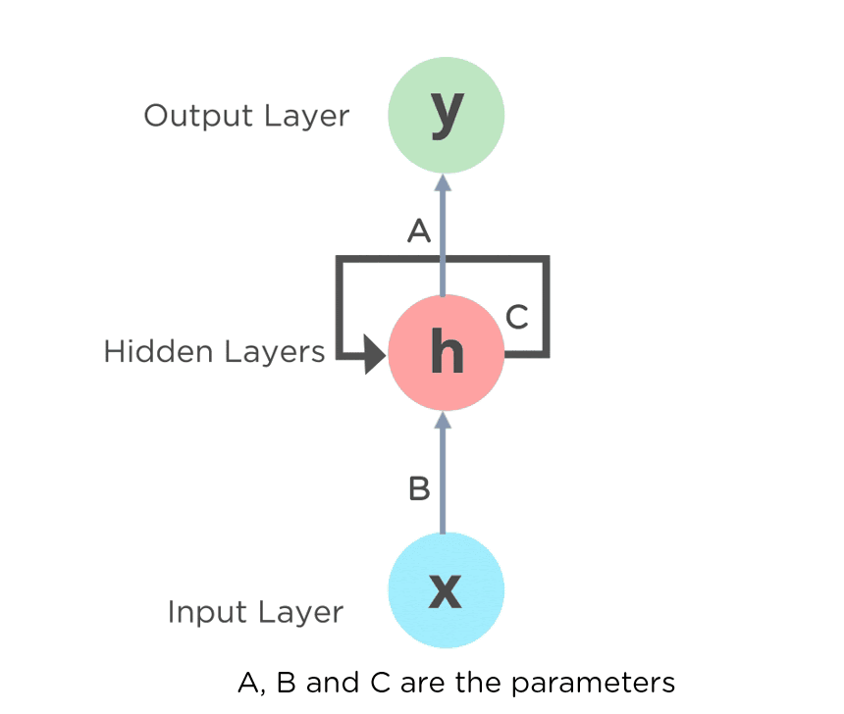
Recurrent Neural Networks
Recurrent means the output at current time step becomes the input to the next time step.
At each element of sequence, the Recurrent Neural Network(RNN) considers not just the current input but what it remembers about the preceding elements.
A RNN contains memory cells which allow the network to learn long-term dependencies in a sequence which means it can take the entire context into account when making a prediction.

Slide 9

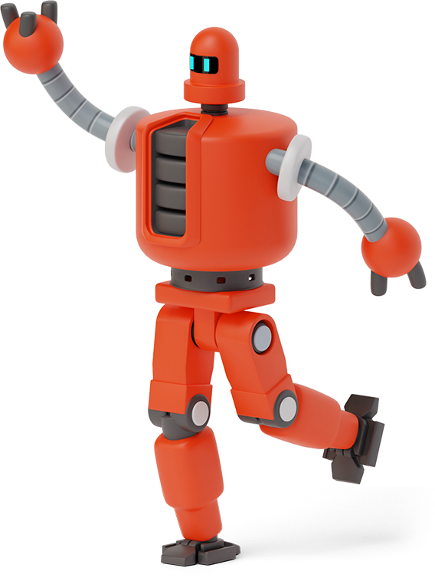
Long Short Term memory
Long short term memory (LSTM) is the most popular cell used in RNN which maintains a cell state as well as a carry state for ensuring that the signal is not lost as the sequence is processed .
LSTM has 3 different gates and weight vectors:
Forget gate
Input gate
Output gate

Slide 10
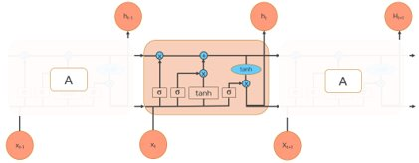
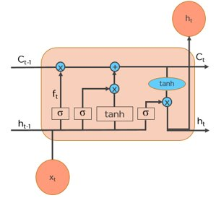
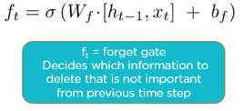
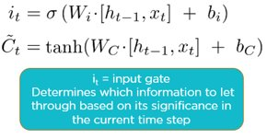
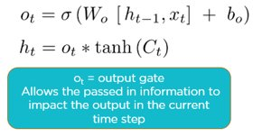

Slide 11
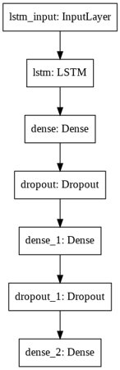
The LSTM Model we made ->

Slide 12
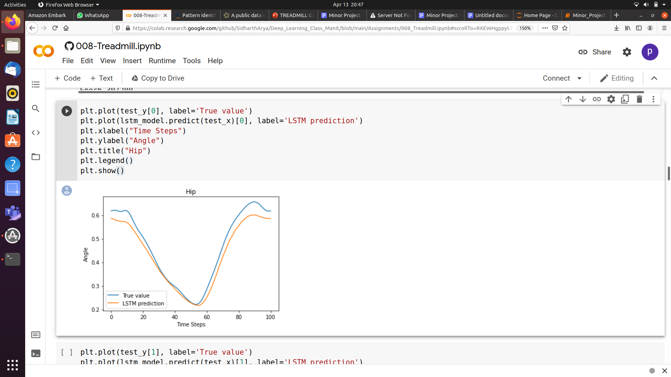
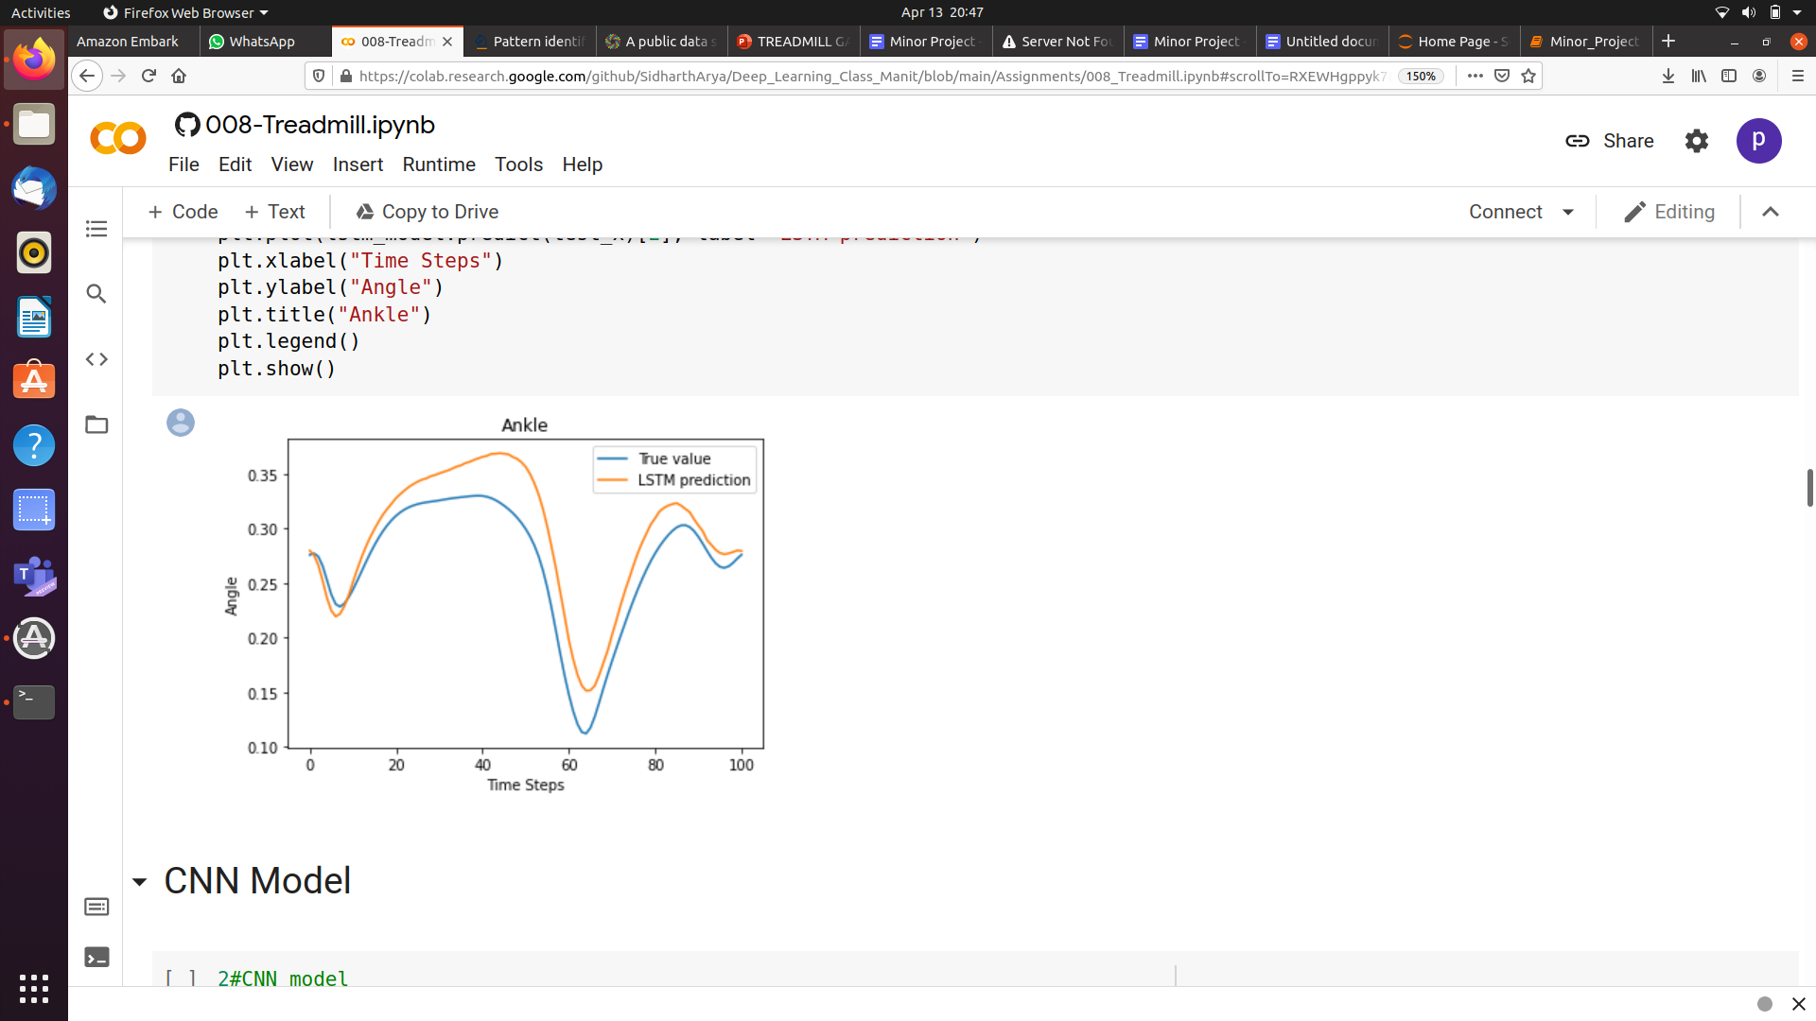
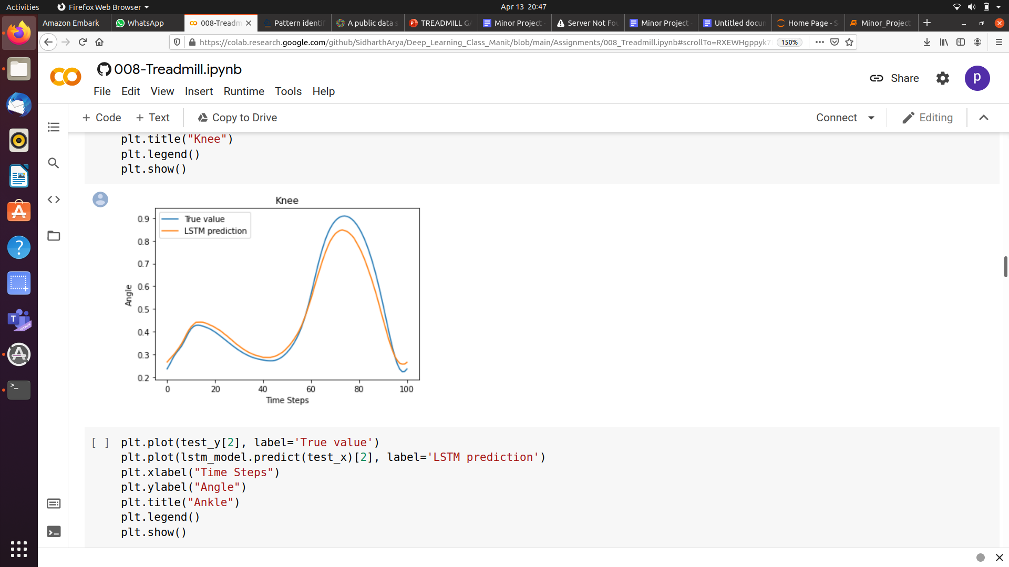
Plot of angular moments of the person for 100 steps through LSTM model and comparing that with the True Prediction

Slide 13

Convolutional Neural Network (CNN)
Convolutional Neural Network (CNN) or ConvNet, is a feed forward neural network that is generally used to analyze visual images by processing data with grid like topology.
It is made up of 4 layers:-
Convolution Layer
ReLU Layer
Pooling Layer
Fully Connected Layer

Slide 14

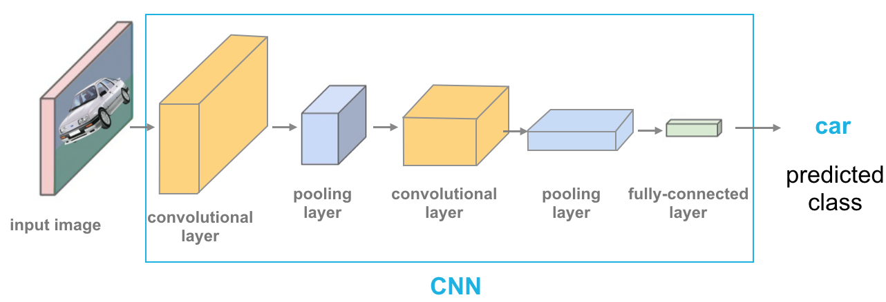
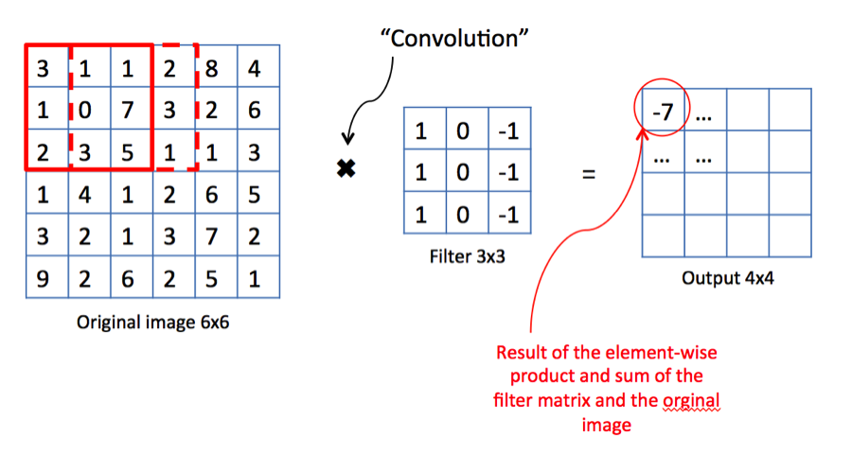


Slide 15
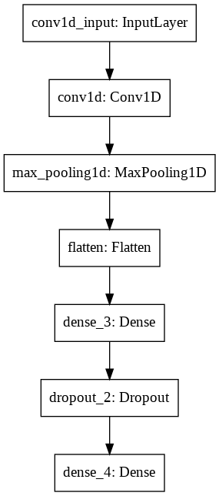
The CNN Model we made ->

Slide 16
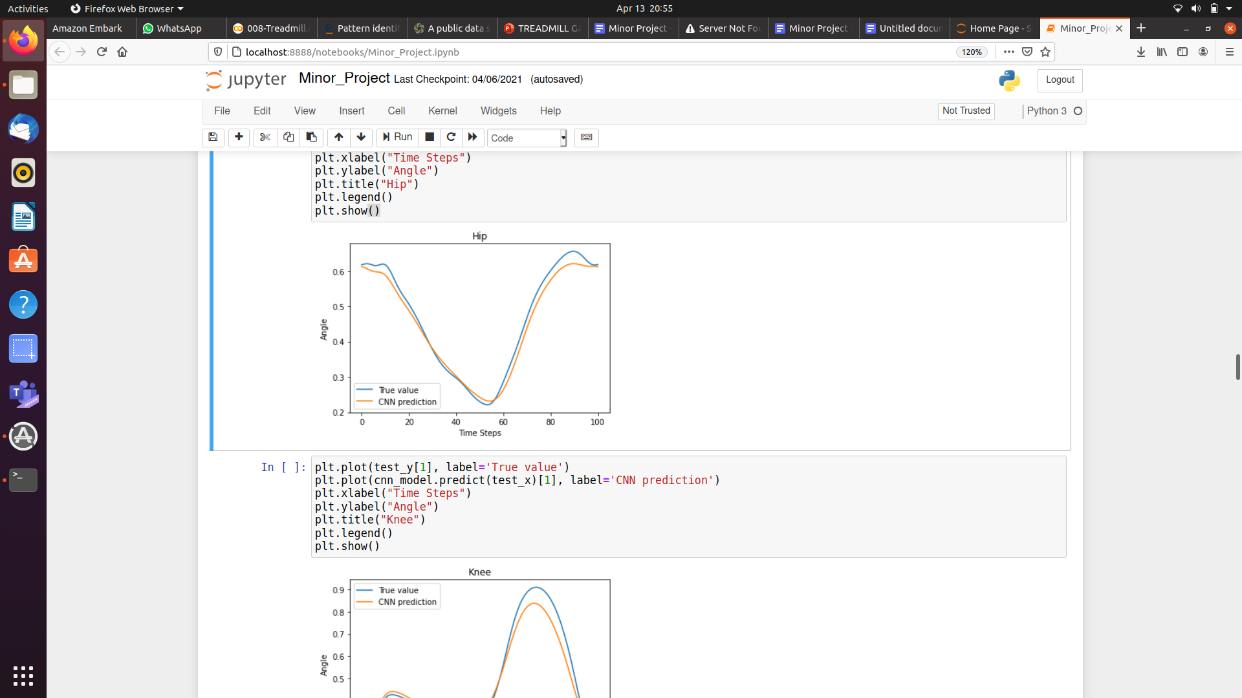
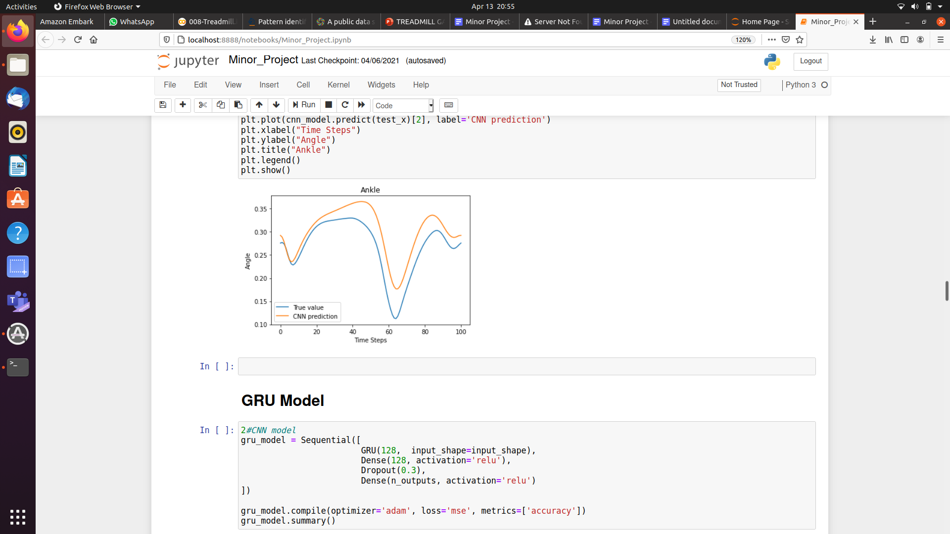
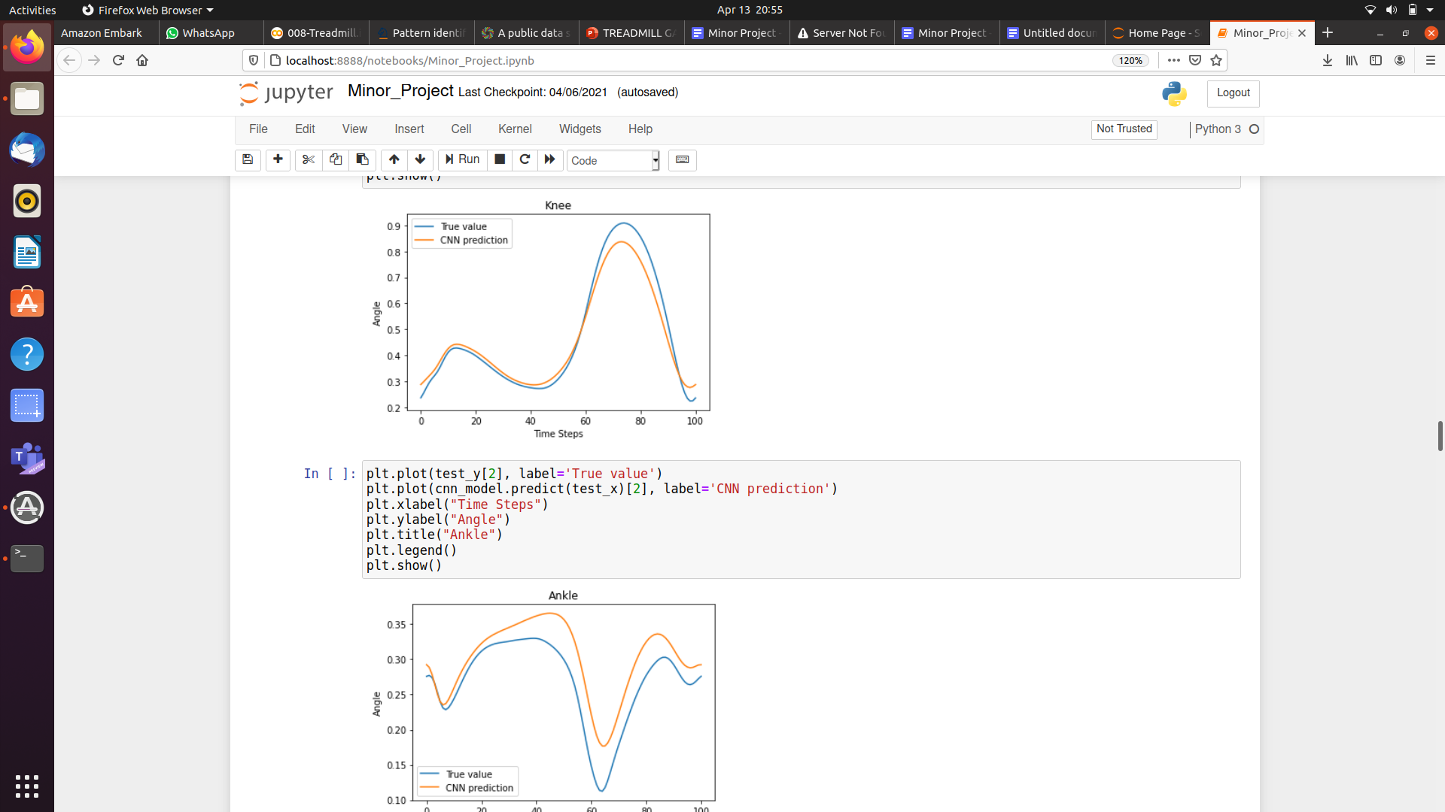
Plot of angular moments of the person for 100 steps through CNN model and comparing that with the True Prediction

Slide 17
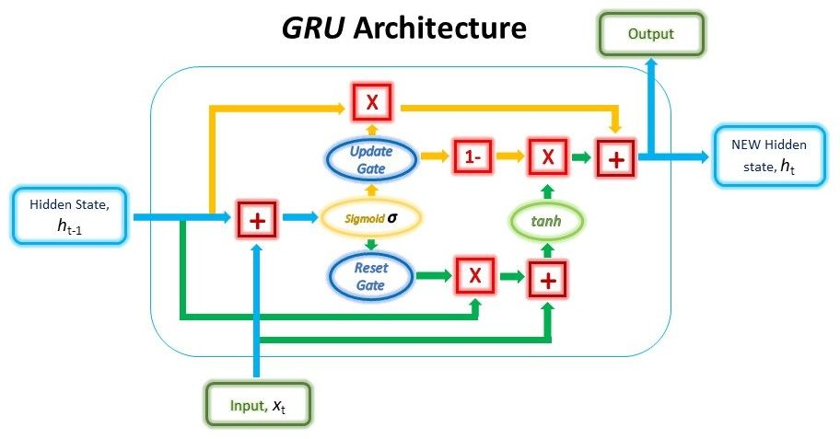
GATED recurrent unit
Gated recurrent unit(GRU), it is another efficient RNN architecture.
GRU has 2 different gates :
Reset gate
Update gate
These gates have their own set of weights that are adaptively updated in their learning phase.

Slide 18
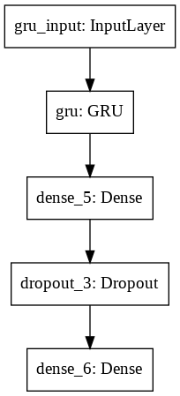
The GRU Model we made ->

Slide 19
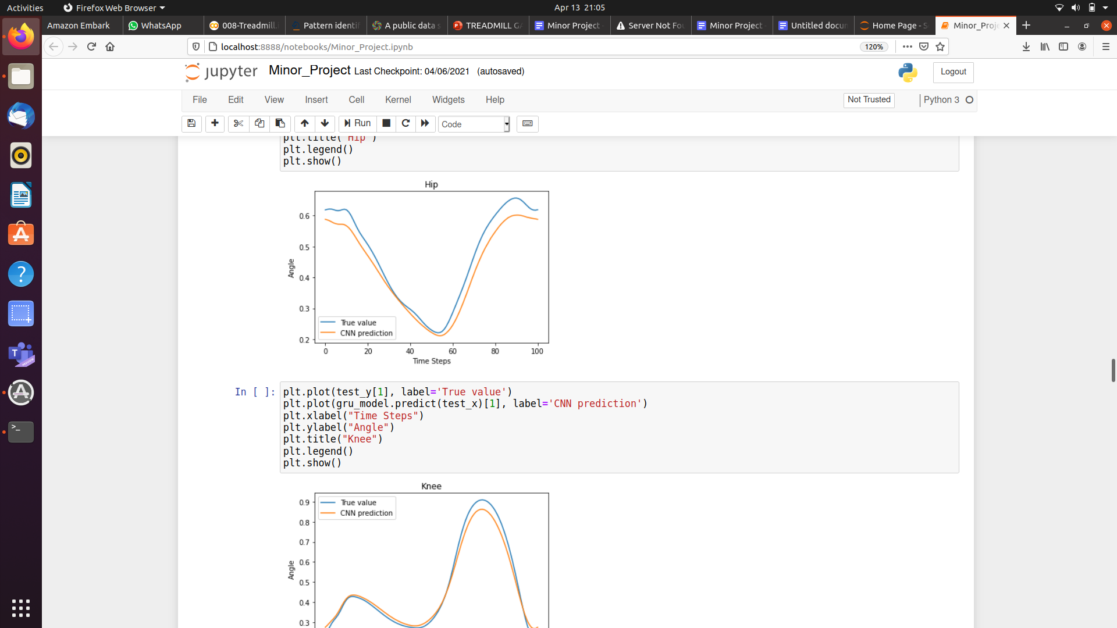
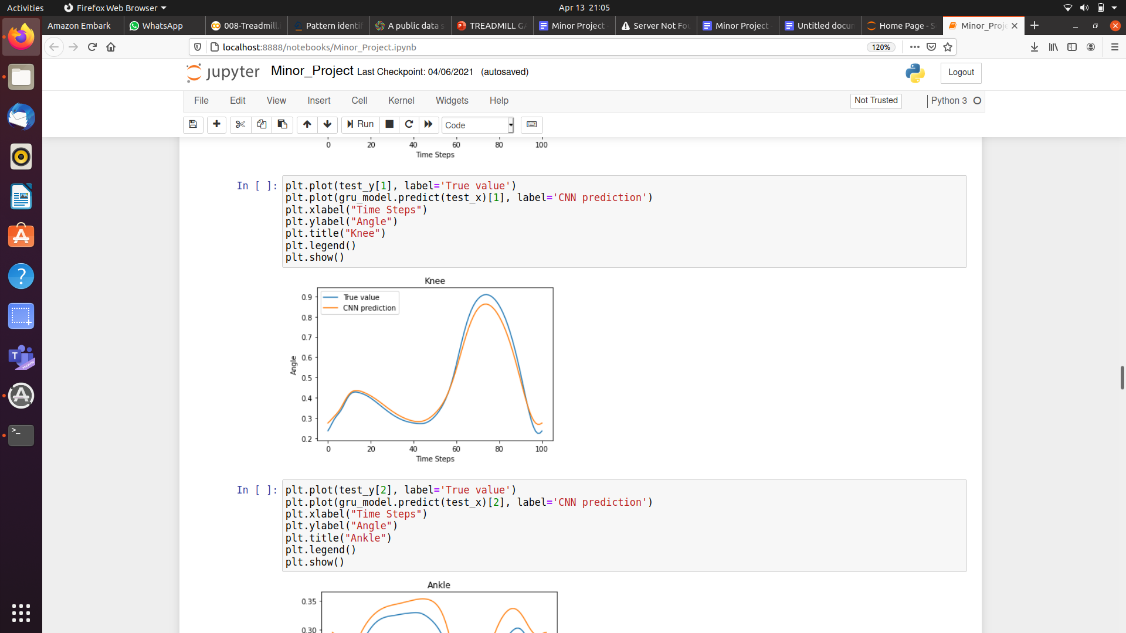
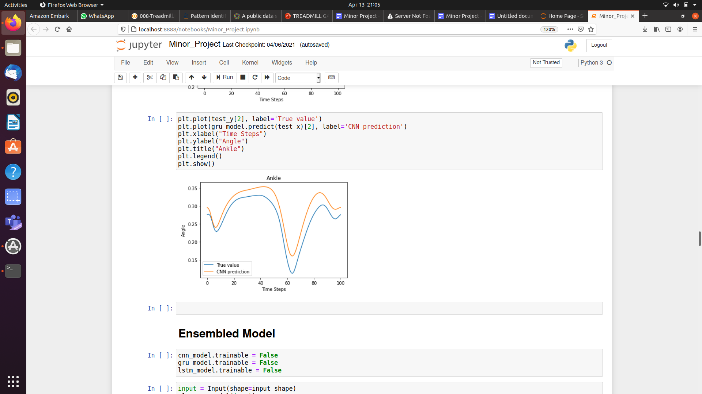
Plot of angular moments of the person for 100 steps through GRU model and comparing that with the True Prediction

Slide 20
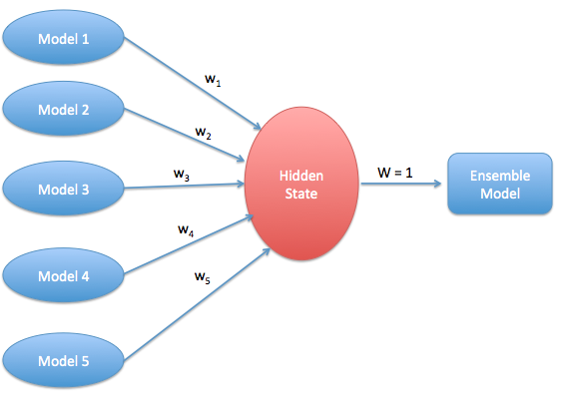
Ensemble mODEL
Ensemble learning helps improve machine learning results by combining several models.
This approach allows the production of better predictive performance compared to a single model.

Slide 21
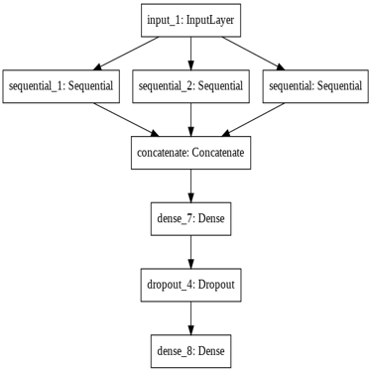
The Ensemble Model we made ->

Slide 22
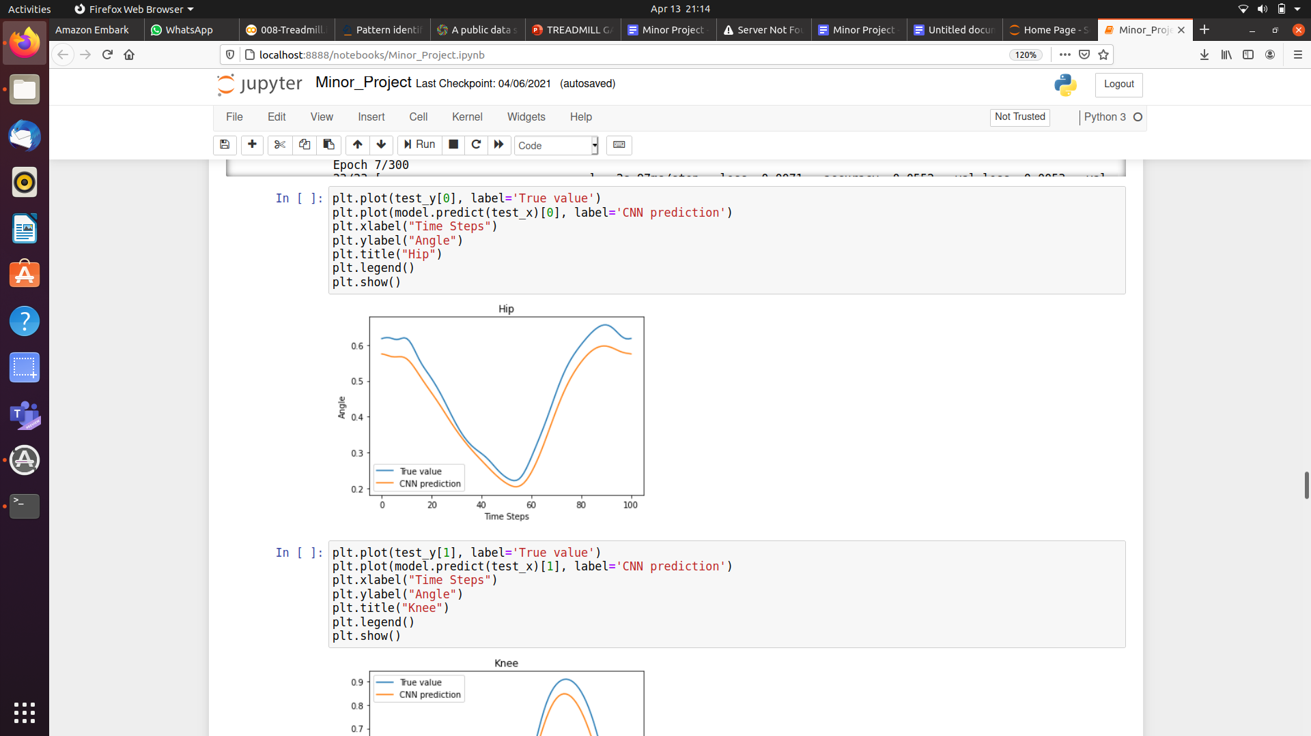
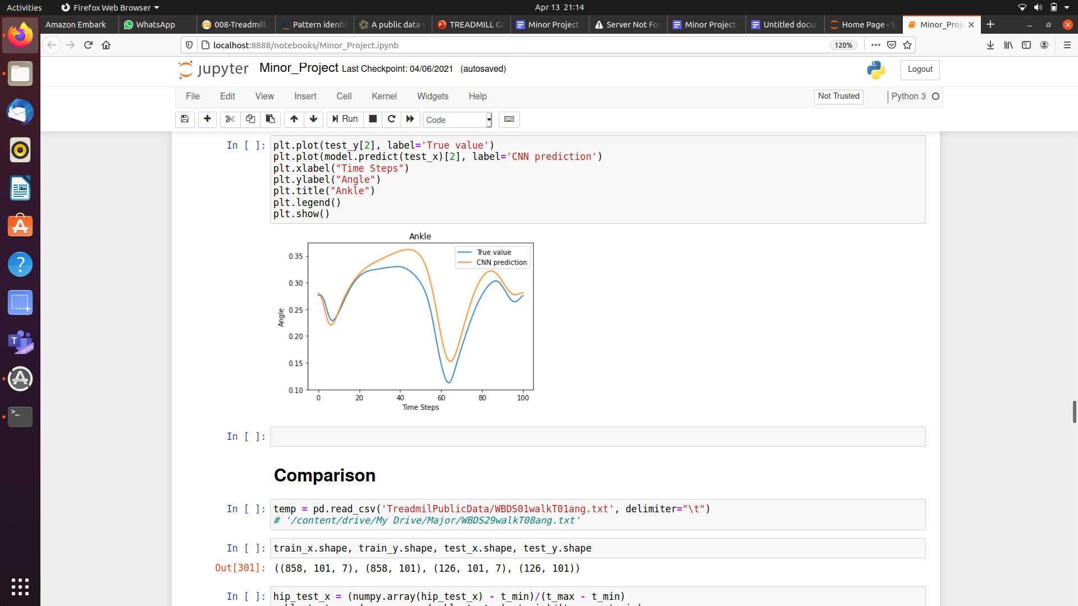
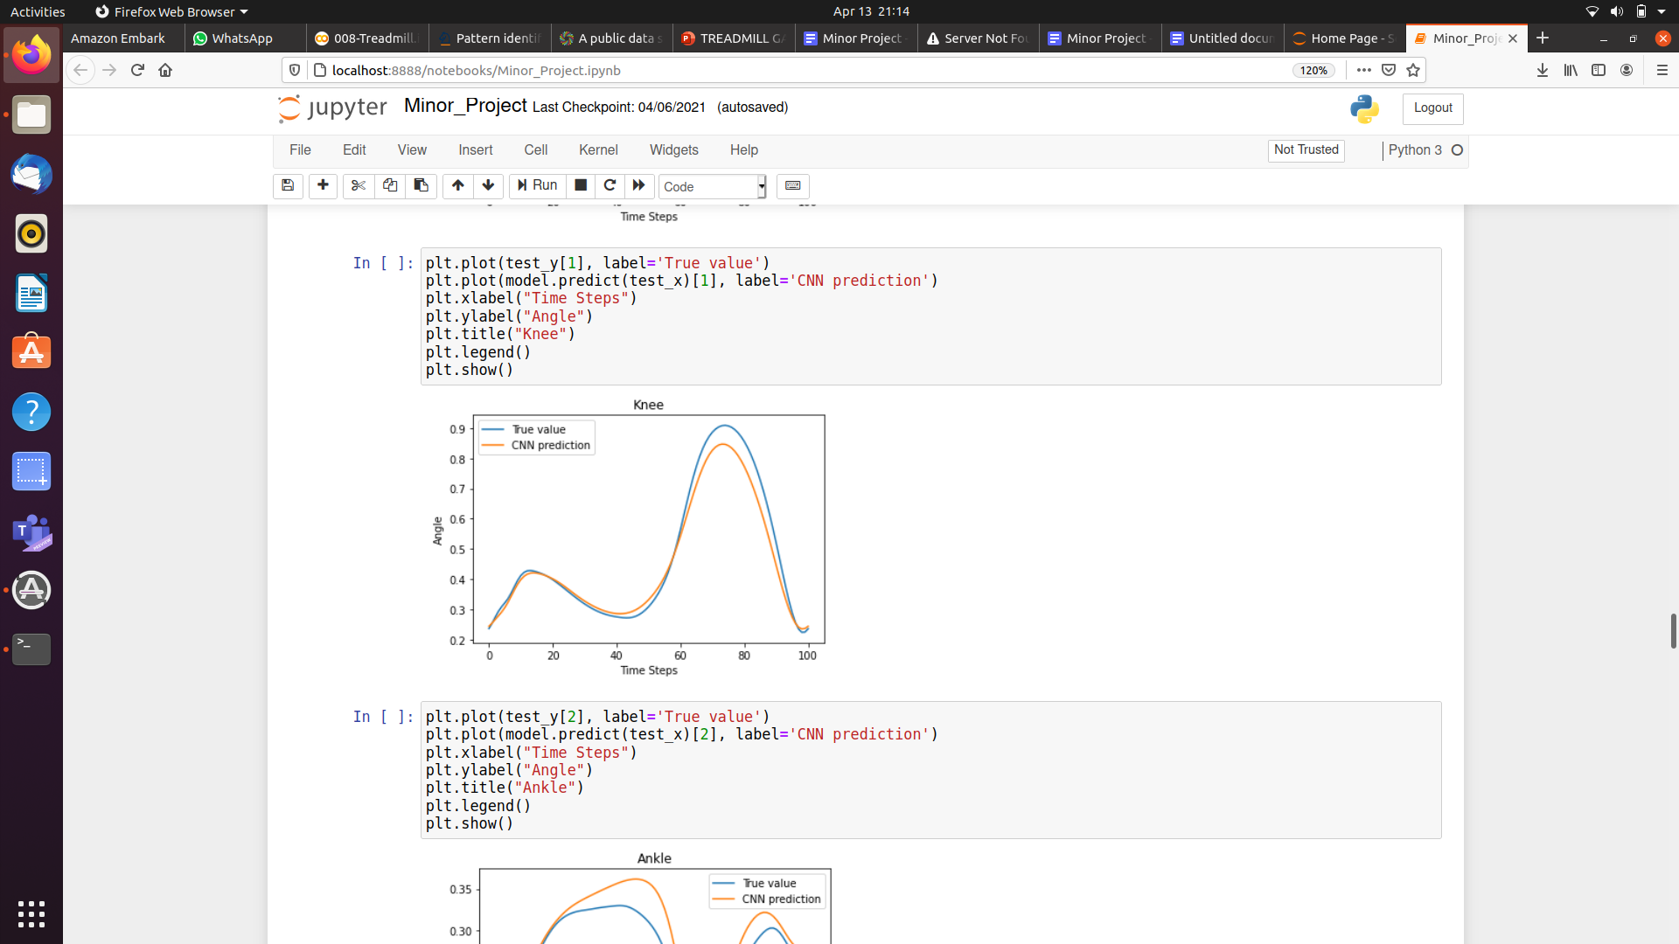
Plot of angular moments of the person for 100 steps through Ensembled model and comparing that with the True Prediction

Slide 23
Comparison of our models

Slide 24
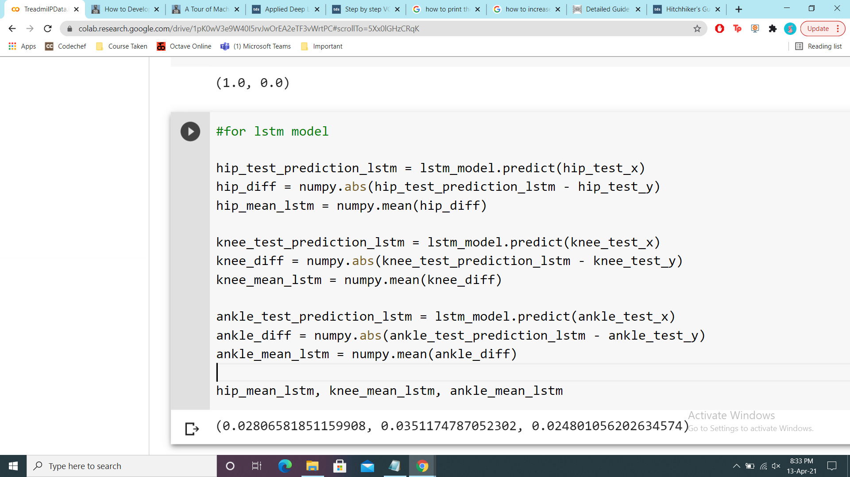
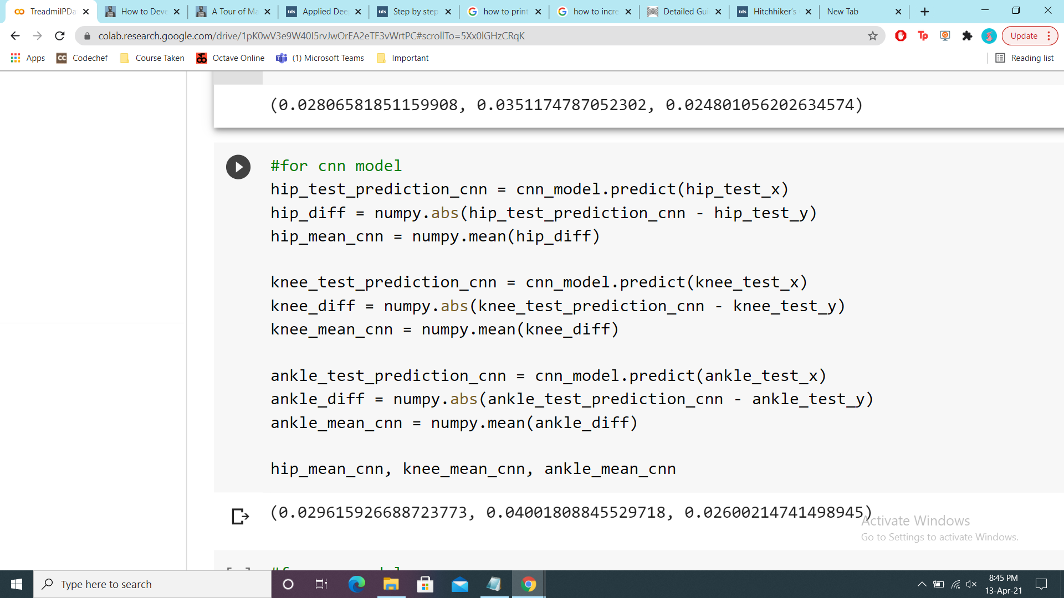
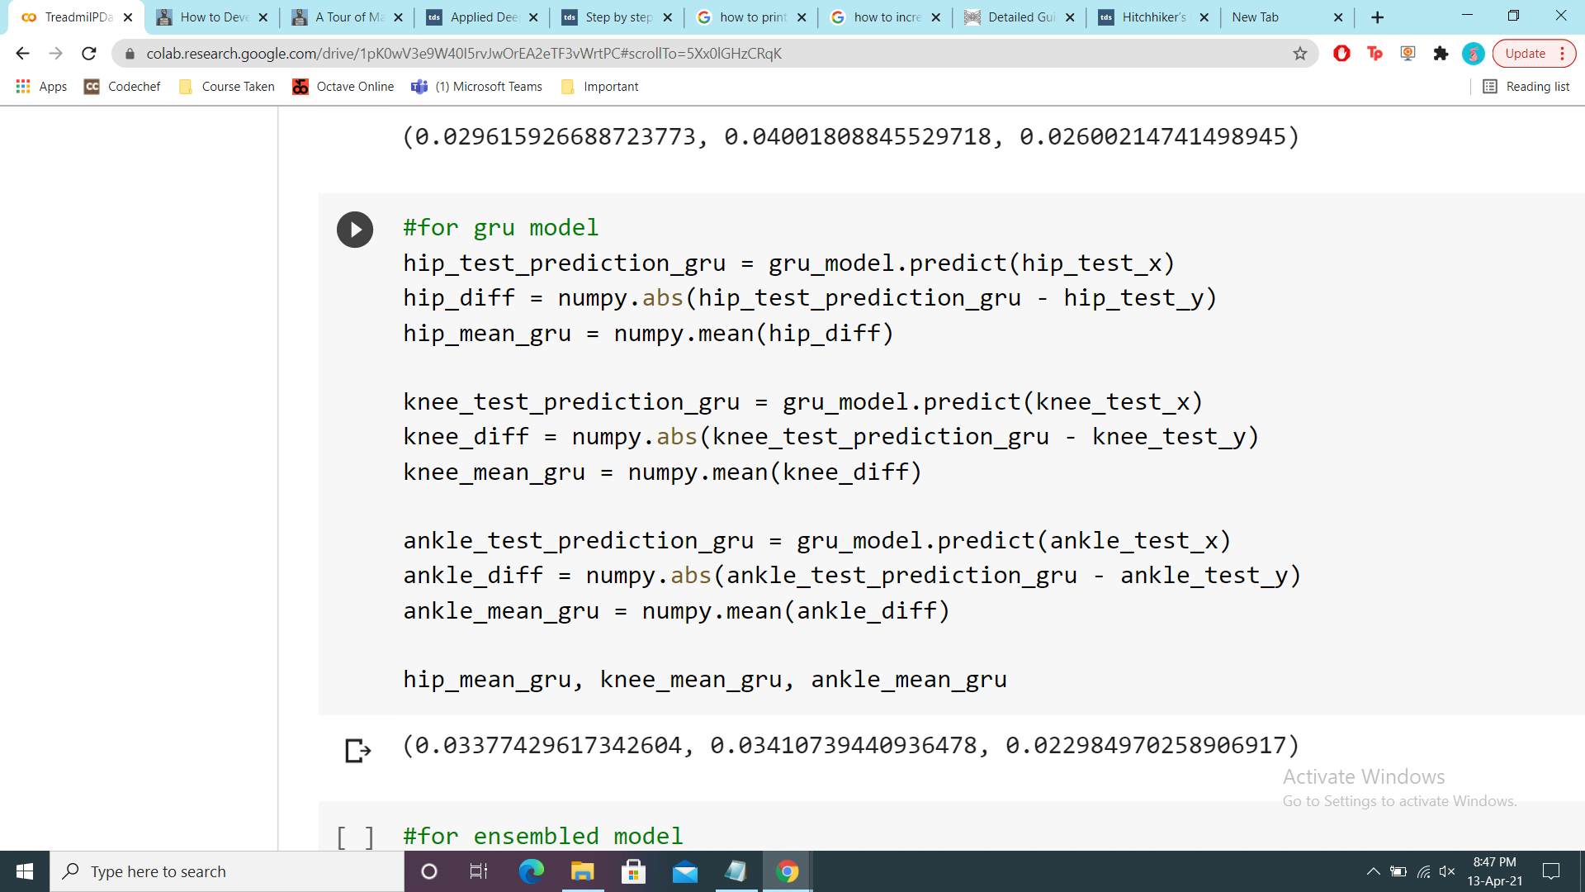
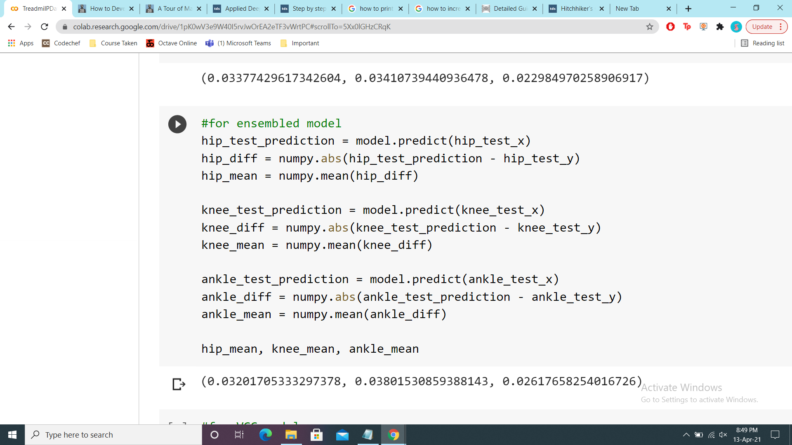

Slide 25
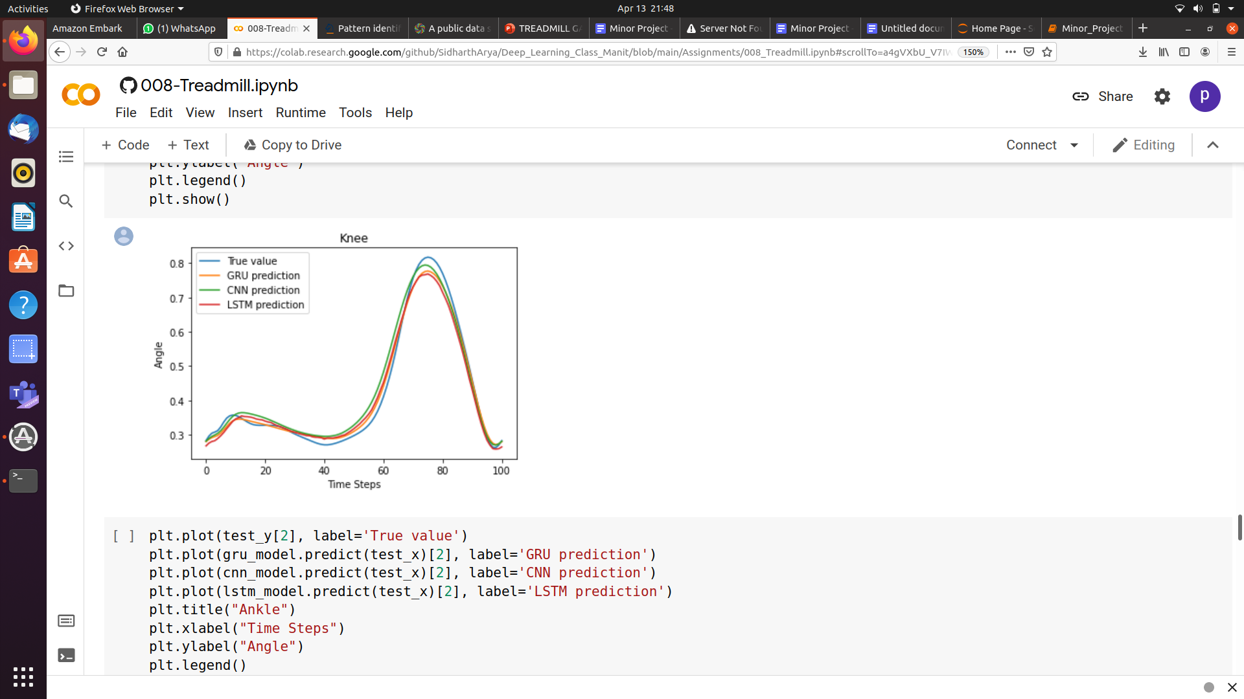
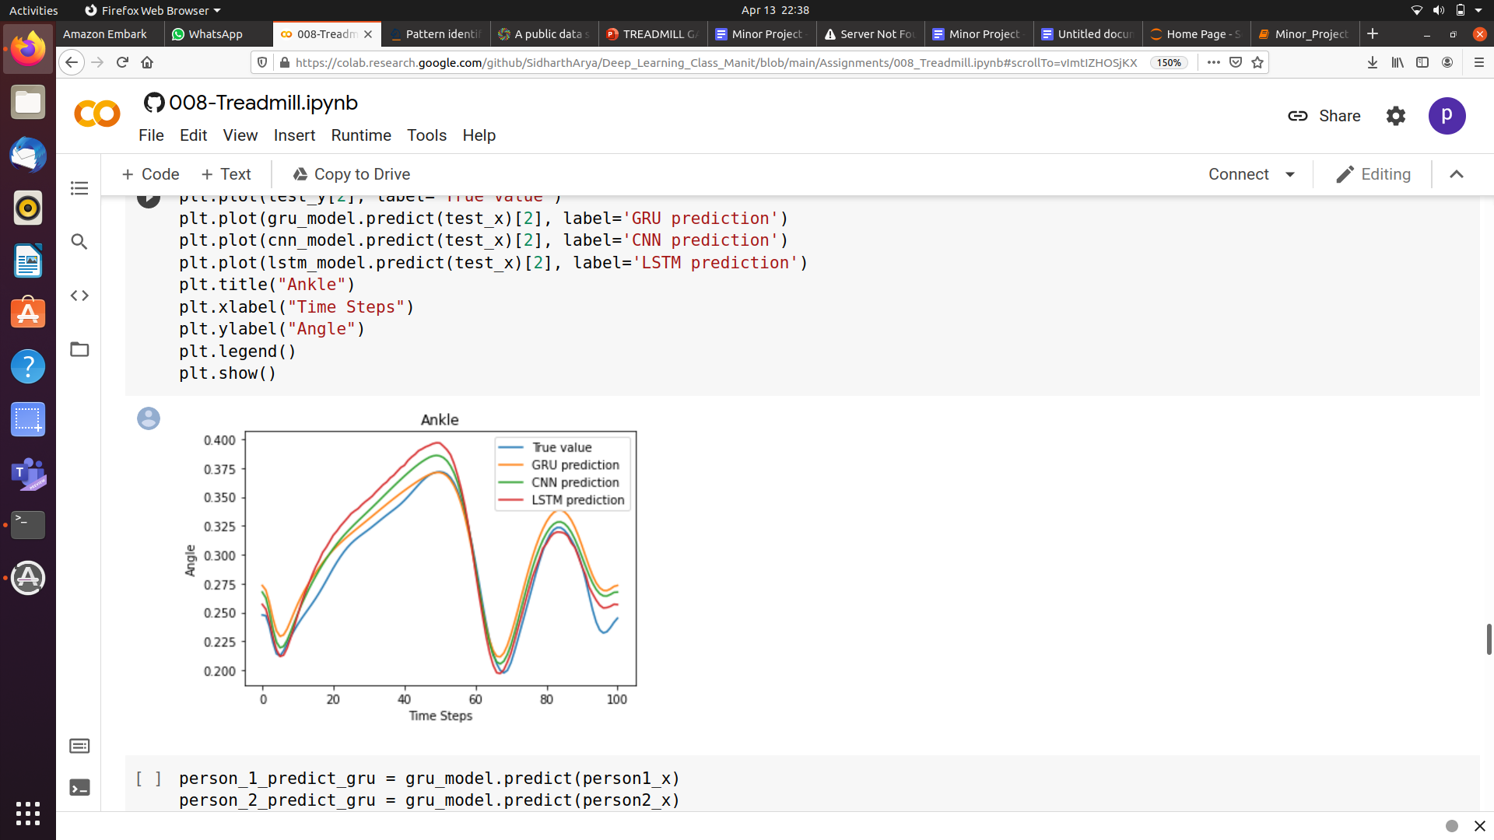
Plot of how the knee, hip and knee angles of the person changes for 100 steps by all the models and comparing that with our True Value.

Slide 26
VGG mODEL
The VGG convolutional neural network architecture, named for the Visual Geometry Group at Oxford, was an important milestone in the use of deep learning methods .
In this we can add many VGG block to make the network more and more deep.

Slide 27
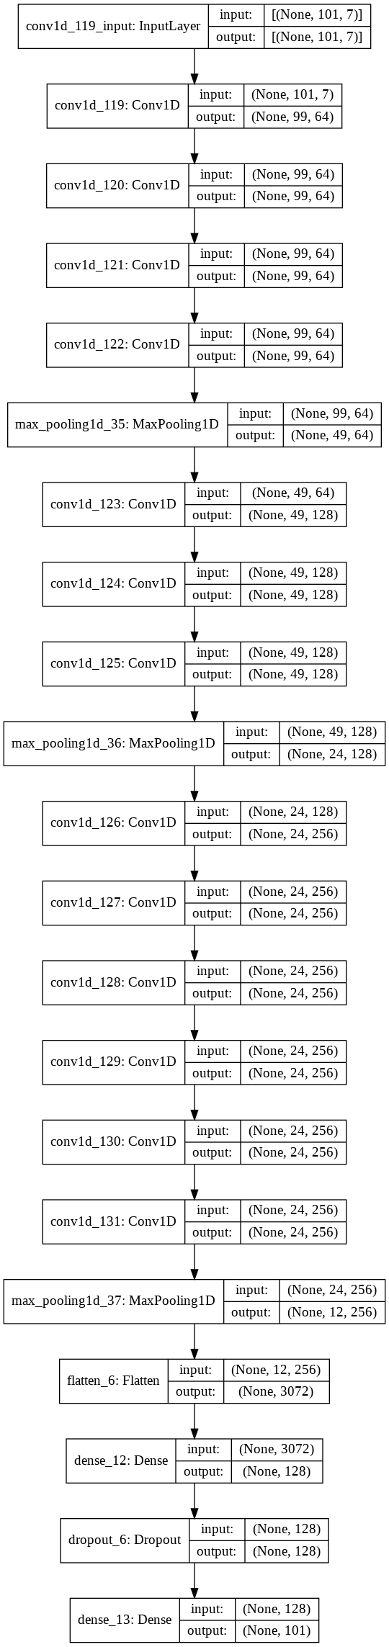
The VGG Model we made ->

Slide 28
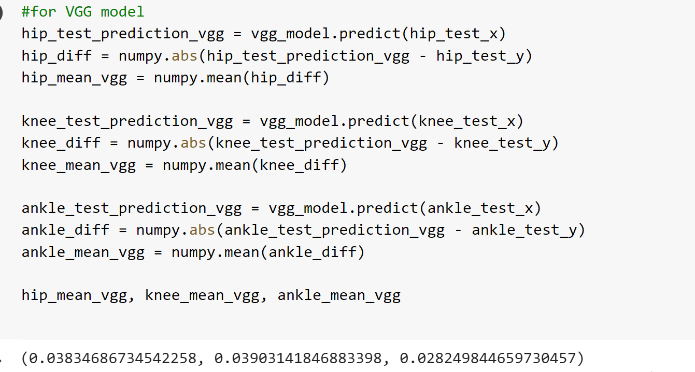

Slide 29
Application
Currently, humanoid robots are not capable of walking like human being. But with our research we can make robot walk like human just by changing the angle and position of ankle , hip and knee of the humanoid robots.

Slide 30
Future scope
Currently the maximum accuracy of all models is 92%. We can use some other model and parameters to increase the accuracy of model and so of our project.
The dataset we used in our project is of human walk on treadmill and overground, for further improvement in bipedal robot we can take a dataset where we make our objects(human) walk on inclined plane like stairs, mountain, etc.

Slide 31
References
https://link.springer.com/article/10.1007/s10462-021-09979-x
https://sites.google.com/view/vsemwal/research/human-activities-gait-data-set
https://towrdsdatascience.com/
https://analyticsvidhya.com/
https://machinelearningmastery.com/
https://machinelearningmastery.com/how-to-implement-major-architecture-innovations-for-convolutional-neural-networks/
DOI 10.7717/peerj.4640
Dua N, Singh SN, Semwal VB (2021) Multi-input CNN-GRU based human activity recognition using wearable sensors. Computing. https://doi.org/10.1007/s00607-021-00928-8
Ekinci M (2006) A new approach for human identification using gait recognition. In: International conference on computational science and its applications. Springer, Berlin

Slide 32
Copyrights
Gupta JP, Polytool D, Singh N, Semwal VB (2014) Analysis of gait pattern to recognize the human activities. IJIMAI 2(7):7–16
Gupta A et al (2020) Multiple task human gait analysis and identification: ensemble learning approach. In: Emotion and information processing. Springer, Berlin
Sivakumar S et al (2016) ANN for gait estimations: a review on current trends and future applications. In: 2016 IEEE EMBS conference on biomedical engineering and sciences (IECBES). IEEE
Copyright 2018 Fukuchi et al.

Slide 33
THANK YOU

